Slide 1
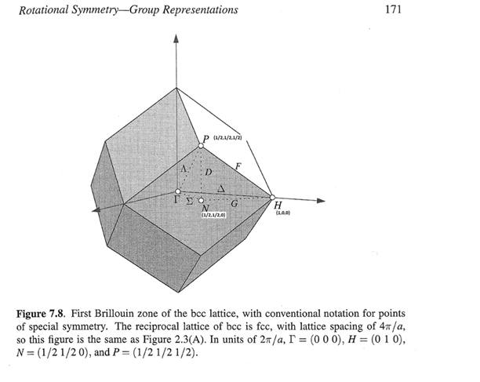
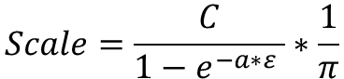
$$Scale=\frac{C}{1−e^{−a∗ε} }∗\frac{1}{π}$$
C=72.7mb/(4*pi*dW*RyTomEv),
a = 1.451meV⁻¹
meV

Slide 2
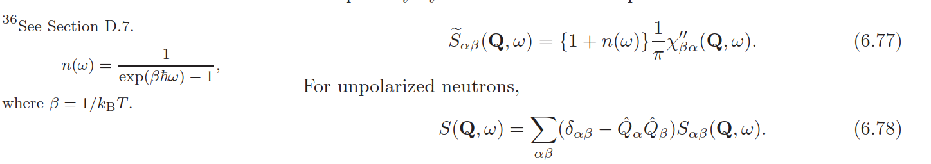
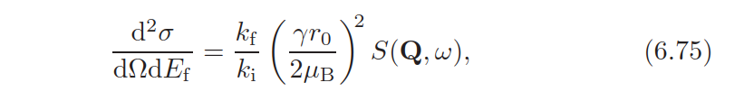
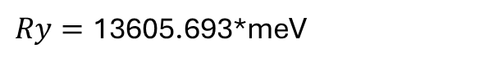
$Ry=\text{13605.693}$*meV
$\frac{d^{2}σ}{dΩ{dE}_{f}}\frac{k_{i}}{k_{f}}={\left(\frac{γr_{o}[m]}{2μ_{B}}\right)}^{2}\left(1+n(ω)\right)\frac{χ^{"}}{π}\left[\frac{{μ_{B}}^{2}}{Ry}\right]=$ $χ^{"}\left(1+n(ω)\right)\frac{γ^{2}{2.818}^{2}∗{10}^{−30}∗{10}^{31}[mBarn]}{4π∗1.36057∗{10}^{4}\left[meV\right]}$=1.6997*10⁻³ $χ^{"}\left(1+n(ω)\right)\left[\frac{mBarn}{meV}\right]$

Slide 3
LDA

Slide 4
GSGW

Slide 5
LDA spaghetti
Linear spin wave theory
fitting

Slide 6
GSGW spaghetti

Slide 7
Amplitude of symmetrised and non- symmetrised SW with and without Magnetic form-factor corrections
Black line – symmetrised with correction
Red line – non-symmetrised
Blue line – symmetrised without correction.

Slide 8
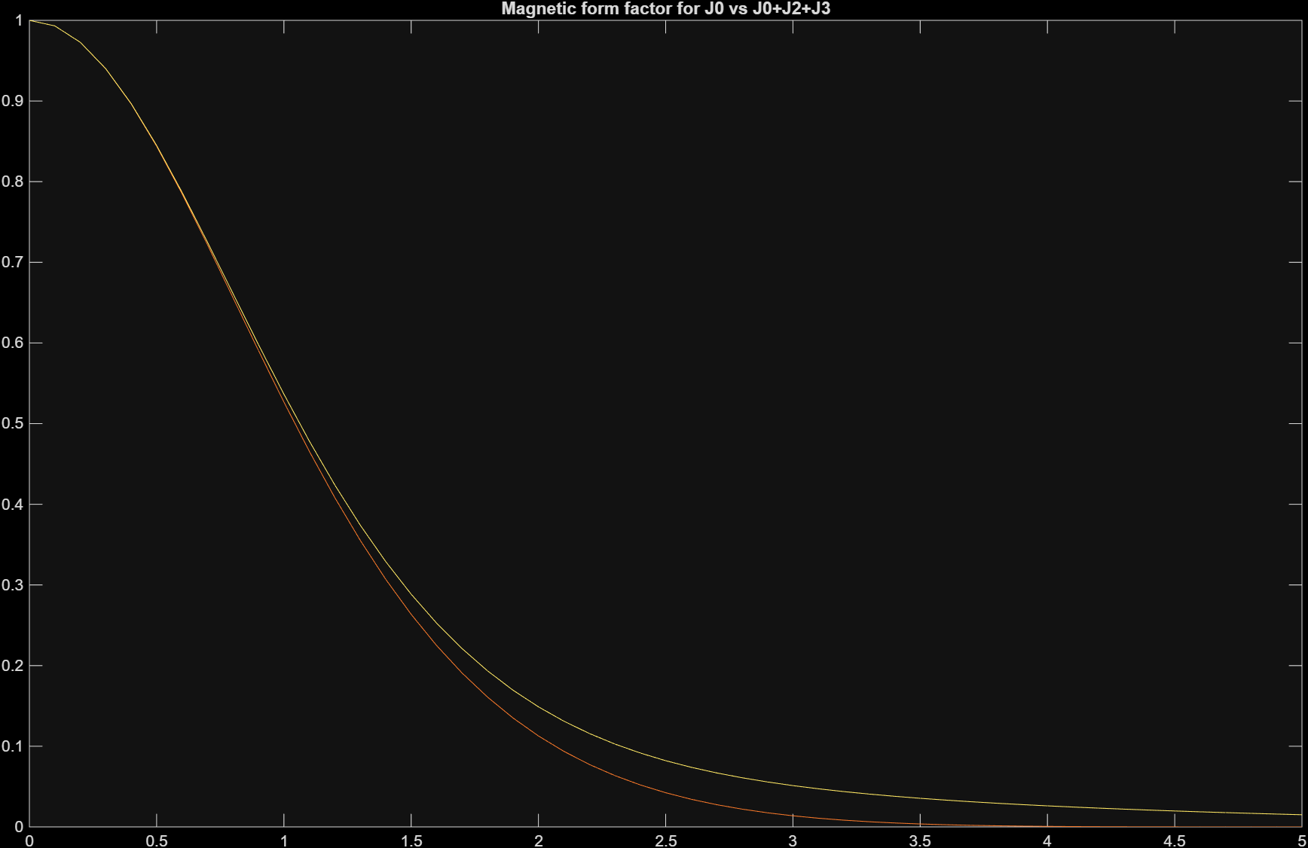
Fitting with form-factor
Fit with J0
Fit with J0+J2+J4 (J6==0)

